Slide 1
A Prophet on the Run Called Again to Service
The Book of Jonah
April 16, 2023

Slide 2
Jonah 3:1-5
¹ Now the word of the Lord came to Jonah the second time, saying, ² “Arise, go to Nineveh the great city and proclaim to it the proclamation which I am going to tell you.” ³ So Jonah arose and went to Nineveh according to the word of the Lord. Now Nineveh was an exceedingly great city, a three days’ walk. ⁴ Then Jonah began to go through the city one day’s walk; and he cried out and said, “Yet forty days and Nineveh will be overthrown.” ⁵ Then the people of Nineveh believed in God; and they called a fast and put on sackcloth from the greatest to the least of them.

Slide 3
Jonah 3:6-8
⁶ When the word reached the king of Nineveh, he arose from his throne, laid aside his robe from him, covered himself with sackcloth and sat on the ashes. ⁷ He issued a proclamation and it said, “In Nineveh by the decree of the king and his nobles: Do not let man, beast, herd, or flock taste a thing. Do not let them eat or drink water. ⁸ But both man and beast must be covered with sackcloth; and let men call on God earnestly that each may turn from his wicked way and from the violence which is in his hands.

Slide 4
Jonah 3:9-10
⁹ Who knows, God may turn and relent and withdraw His burning anger so that we will not perish.” ¹⁰ When God saw their deeds, that they turned from their wicked way, then God relented concerning the calamity which He had declared He would bring upon them. And He did not do it.

Slide 5
A Prophet on the Run
I. Sovereign to Send
II. Sovereign to Save
III. Sovereign to Spare
IV. Sovereign to Scold

Slide 6
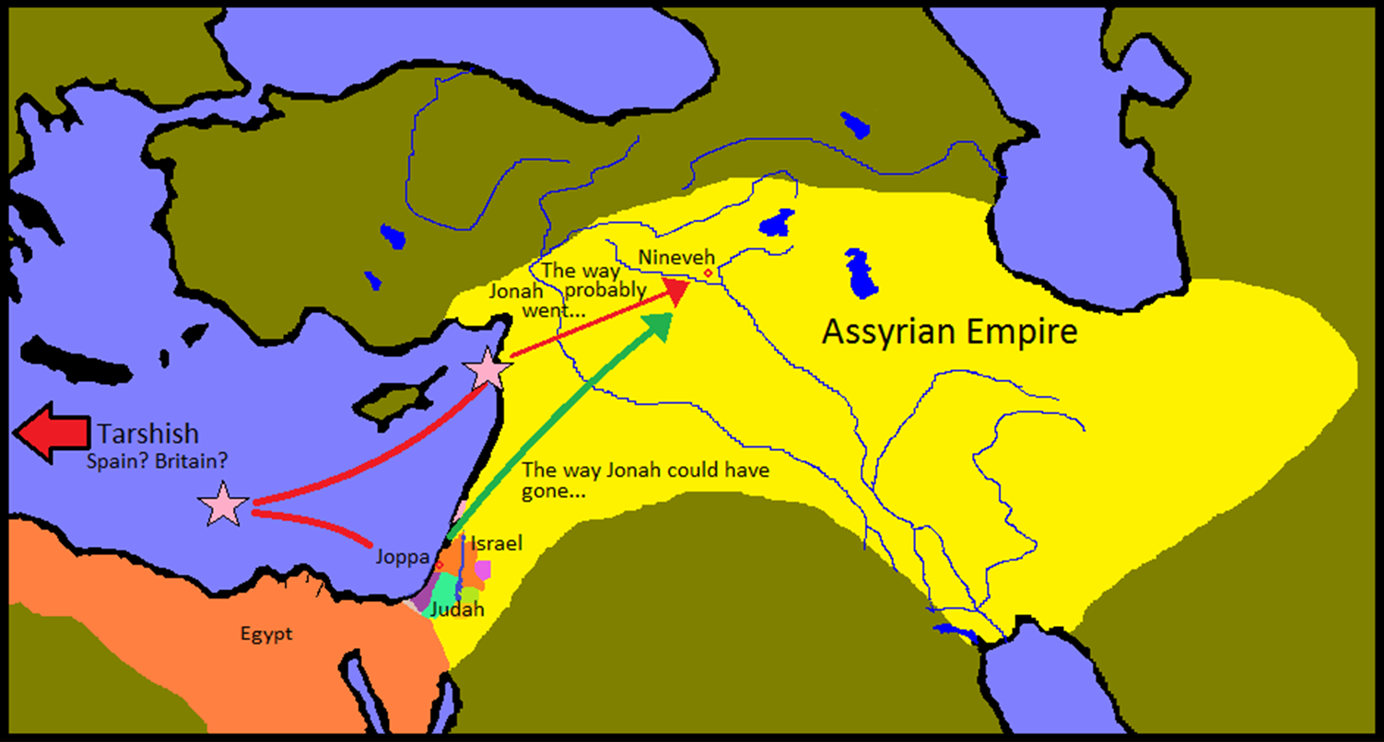
A Prophet on the Run

Slide 7
A Prophet on the Run
III. Sovereign to Spare (3:1-10)
A. Sent Again (3:1-4)

Slide 8
A Second Call
Hosea 1:2 “Go, take to yourself a wife of harlotry and have children of harlotry, for the land commits flagrant harlotry, forsaking the Lord.”
Hosea 3:1 “Go again, love a woman who is loved by her husband, yet an adulteress, even as the Lord loves the sons of Israel, though they turn to other gods and love raisin cakes.”

Slide 9
A Second Call
Jonah 1:1 “The word of the Lord came to Jonah the son of Amittai saying”
Jonah 3:1 “Now the word of the Lord came to Jonah the second time, saying.”

Slide 10
A Second Call
Jonah 1:2 “Arise, go to Nineveh the great city and cry against it, for their wickedness has come up before Me.”
Jonah 3:2 “Arise, go to Nineveh the great city and proclaim to it the proclamation which I am going to tell you.”

Slide 11
A Second Call
Jonah 1:3a “But Jonah rose up to flee to Tarshish from the presence of the Lord.”
Jonah 3:3a “So Jonah arose and went to Nineveh according to the word of the Lord.”

Slide 12
Ezekiel 36:26-29
²⁶ Moreover, I will give you a new heart and put a new spirit within you; and I will remove the heart of stone from your flesh and give you a heart of flesh. ²⁷ I will put My Spirit within you and cause you to walk in My statutes, and you will be careful to observe My ordinances. ²⁸ You will live in the land that I gave to your forefathers; so, you will be My people, and I will be your God. ²⁹ Moreover, I will save you from all your uncleanness; and I will call for the grain and multiply it, and I will not bring a famine on you.

Slide 13
Ezekiel 36:30-31
³⁰ I will multiply the fruit of the tree and the produce of the field, so that you will not receive again the disgrace of famine among the nations. ³¹ Then you will remember your evil ways and your deeds that were not good, and you will loathe yourselves in your own sight for your iniquities and your abominations.

Slide 14
A Prophet on the Run
III. Sovereign to Spare (3:1-10)
A. Sent Again (3:1-4)
B. Born Again (3:5-9)

Slide 15
A Prophet on the Run
III. Sovereign to Spare (3:1-10)
A. Sent Again (3:1-4)
B. Born Again (3:5-9)
C. Gracious Again (3:10)

Slide 16
40 Time Span
40 days Moses was on the mountaintop
40 days the spies where in the land
40 days Jesus spent in the wilderness
40 days and nights it rained
40 days Jesus spent after His resurrection and before His ascension
40 days Goliath taunted Saul’s army before David arrived to slay him
40 days and nights Elijah fled from Jezebel
40 years wondering in the desert

Slide 17
A Prophet on the Run Called Again to Service
The Book of Jonah
April 16, 2023

